Slide 1
ISSUES (SCISM) &
PROPOSALS (EEAS)
Andrei Popovici, EEAS-EXT
e-mail: Andrei-Mihai.Popovici@ext.eeas.europa.eu

Slide 2
ISSUES & PROPOSALS
  Issue to solve:
    .
Answer
SDA Access request
Content
Manager (CM)

Slide 3
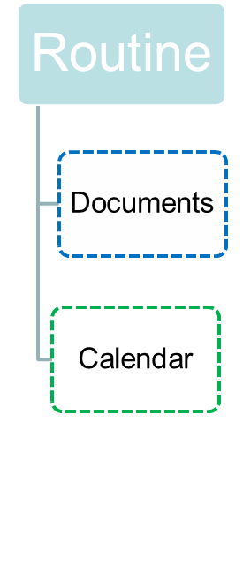
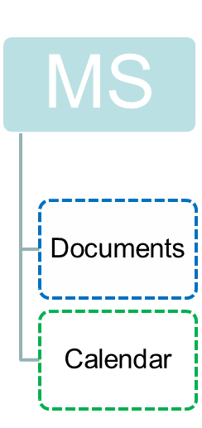
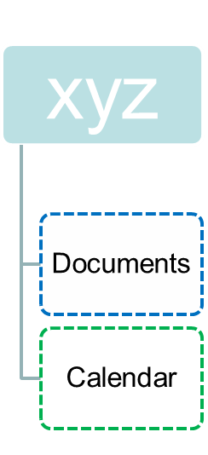
ISSUES & PROPOSALS
  Issue to solve:
Current structure should be changed:
-Naming
-Management difficulties

Slide 4
ISSUES & PROPOSALS
  Proposed solution:
  Evolving CAMEO SDA structure
    The current CAMEO SDA structure will evolve
    Additional proposed SDAs (see table below, = to be added)
L0 | L1 | L2 | L3….
ROUTINE | See production | Content Manger's design
MSx | e.g. DE, NL, UK etc | e.g OHQ, FHQ, MOD etc
EU EXERCISES | e.g. MILEX 15 | 16 etc | e.g DISTAFF, OHQ, FHQ
OPS-MISSIONS | e.g. EUTM CAR, MALI etc | Content Manger's design
USER COMMUNITIES | e.g. SATCEN, EUMS etc | Content Manger's design

Slide 5
ISSUES & PROPOSALS
  Evolving CAMEO SDA structure
    Lx = levels of depth in the SDA structure
    Existing SDAs will be kept in the new structure or archived (TBD)
    Length of name for L2 = 15 chars ( to see entire name in the navigation area)
    Content Managers (CMs) to be nominated by EUMS IMC and assigned to CM Roles attached to SDAs by CAMEO Manager
    For an account Acc1 to gain visibility in an SDA structure like ROOT (L0)/ SDAx(L1) / SDA1(L2) / SDA2(L3) where there are different CMs at each level Lx, e.g. {CMx(SDAx), CM1(SDA1), CM2(SDA2)}, CM2 must follow the following steps:
      Step1: Request to CMx that Acc1 is assigned to Associate (SDAx) in order to see the SDA structure of SDAx
      Step2: Request to CM1that Acc1 is assigned to Associate (SDA1) in order to get visibility within SDA1
      Step3: CM2 assigns Acc1 to the appropriate role within SDA2 (CM | Contributor | Associate) based on "need to know"/"need to share" principles.

Slide 6
ISSUES & PROPOSALS
  Roles capabilities in CAMEO
Role / Capability | Account Management | Create / Delete SDA (L1) | Create / Delete subSDA (L2) | Create / Delete subSDA (L3, L4 etc) | Assign account to CM role | Assign existing CAMEO account to groups | Assign existing CAMEO account /group to role | Grant access rights to folders and docs in an SDA | Create Folder | Upload updated document in (sub)SDA / Folder
CAMEO Manager | Y | Y | Y | Y | Y | Y | Y | Y | Y | Y
Content Manager | N | N | Y | Y | Y | Y | Y | Y | Y | Y
Contributor | N | N | N | N | N | N | N | N | N | Y
Associate | N | N | N | N | N | N | N | N | N | N

Slide 7
ISSUES & PROPOSALS
  Default access rights (AR) of roles within an SDA :
AR / Role | CM | Contributor | Associate
Read | Y | Y | Y
Write | Y | Y | N
Delete | Y | N | N
Assign | Y | N | N

Slide 8
ISSUES & PROPOSALS
  Default access rights (AR) of roles to Document/Folder/Calendar/Forum:
AR / Role | CM | Contributor | Associate
NoAccess | N | N | N
Read | Y | Y | Y
Write | Y | Y | N
Delete | Y | N | N
Assign | Y | N | N

Slide 9
ISSUES & PROPOSALS
  Default access rights (AR) of roles to Document/Folder/Calendar/Forum:
    Default access rights coming with the role can be refined by CM for specific accounts that belong to the role.
    Example: Acc1 belongs to Associate role. For a specific document within a folder, the CM can grant Acc1 the "Delete" access right or even "Assign", meaning that for the respective document, Acc1 has the same privileges like the CM. This could apply particularly to authors of documents, to give them the freedom to manage the access to documents they produced within the folder and the (sub)SDA where they have been assigned.

Slide 10
ISSUES & PROPOSALS
  Default access rights (AR) of roles to Document/Folder/Calendar/Forum:
    A CM can be assigned to ROUTINE SDA to manage / refine accounts/groups access to existing documents of PUBLIC interest;
    Example: assign external accounts (i.e assigned to MSx SDA) to have AR = R to ROUTINE docs ( normally available for accounts belonging to EUMS SDAs)
    CM can refine access of accounts according to previous table to any objects like Document / Folder /Calendar / Forum.

Slide 11
ISSUES & PROPOSALS
  Proposed workflow:
    Requests of creation of new SDAs (L0) and sub-SDAs (L1) must be submitted and confirmed by SCISM. SCISM continues to be the gateway in relation with this type of requests.
    Requests of appointments of CMs for SDAs(L0) and SDAs(L1) should be submitted and confirmed by SCISM. SCISM continues to be the gateway in relation with this type of requests.
    Requests for access to Documents / Folders / Calendar / Forum within a sub-SDA (L2 and below) can be submitted to and implemented directly by the appointed CMs for the respective sub-SDAs ( provided the respective accounts requesting access are already created in CAMEO and irrespective to what SDA they belong)

Slide 12
ISSUES & PROPOSALS
  Posibility of a transition from nominal CAMEO accounts (EUMS) to functional CAMEO accounts
    Member States are using functional accounts in their SDAs
    EUMS has expressed an interest to use functional accounts instead of the nominal accounts which are currently used
    The existing CAMEO nominal accounts cannot have their CAMEO name edited according to a new functional name. The only attribute of a CAMEO account that can be modified is its status, i.e. (Active, Inactive).
    EUMS can start using functional account names only for future accounts that will be granted access to CAMEO.

Slide 13
Comments?
Thank you!

